Slide 1
December 29, 2010
D. Trbojevic

Slide 2
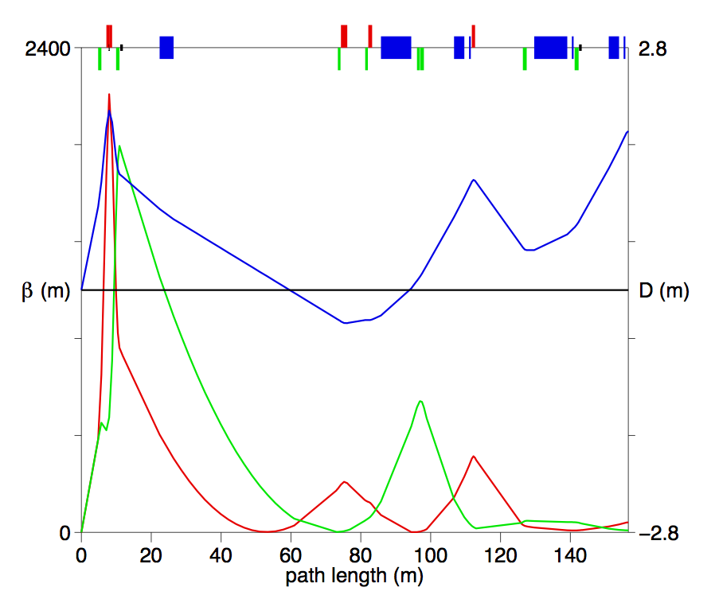

Slide 3
December 22, 2010, IP configuration for eRHIC
0.96 m
1.64 m
0.92 m
5.4 m
1.1m
1.45 m
p_{c}/2.5
1.90 m
D=120 mm
θ=10 mrad
θ=4 mrad
1.9 cm
ZDC
4.80 m
θ=10 mrad
IP
2
4
6
8
10
12
14
16
Combined function:
0.92 m, 3.60 T, 19 T/m
θ=4 mrad
beam
neutrons
D=120 mm

Slide 4
4 m
Q4
Q5
D5
θ=11.69 mrad
39.9 m
θ=4 mrad
0.44843 m
0.2582 m
0.315726 m
5.4 m
10 mrad
5.75 cm
4.8
10
20
30
10.89 m
60.0559 m
90.08703 m

Slide 5
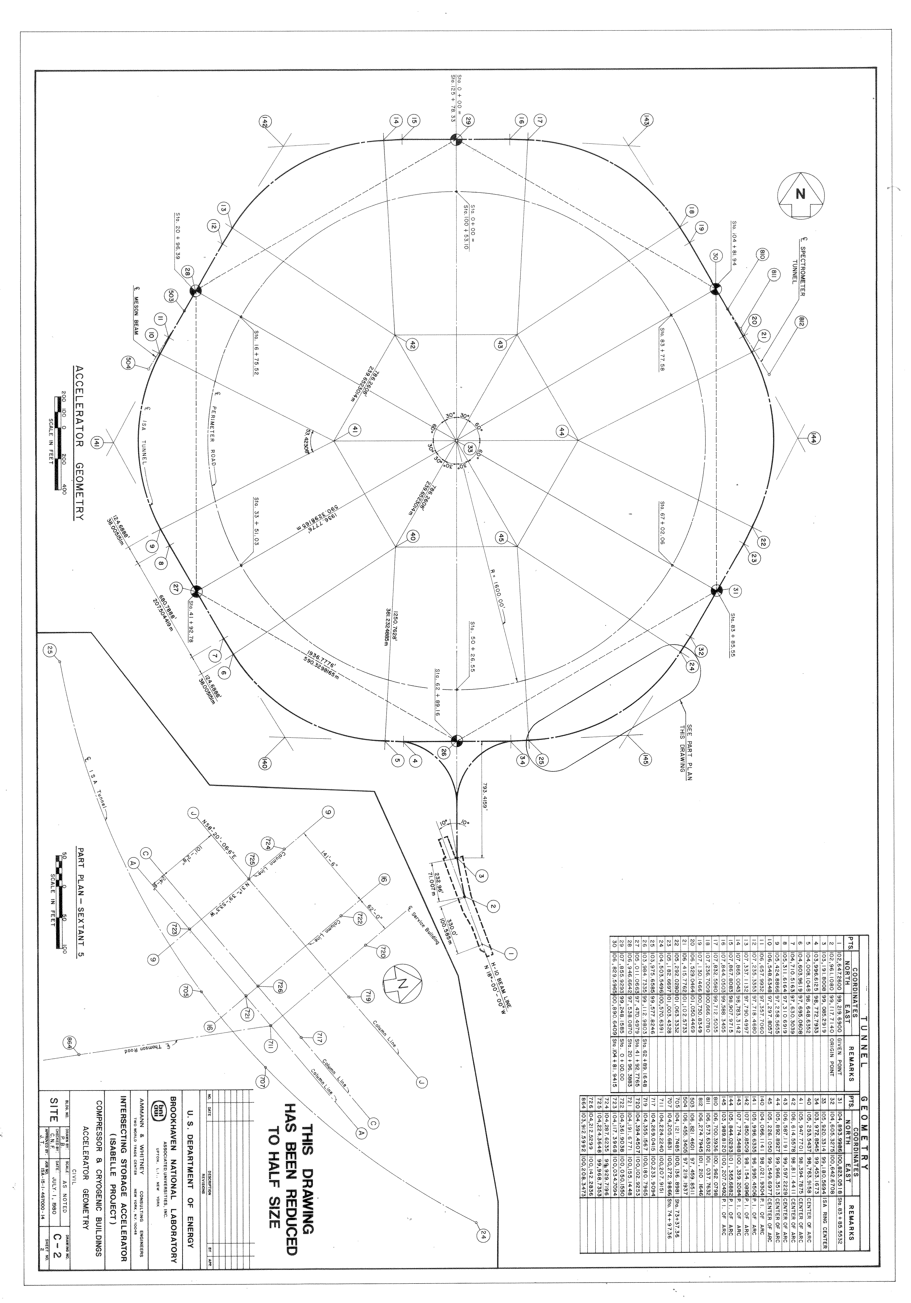
RHIC GEOMETRICAL ARC LAYOUT
s=207.50442m
Δr=32.147882 m
s=103.75221 m
r=378.26477m
s₁=410.62572m
R=590.32982m
2.96771
h=207.54498 m
l=355.46447 m

Slide 6
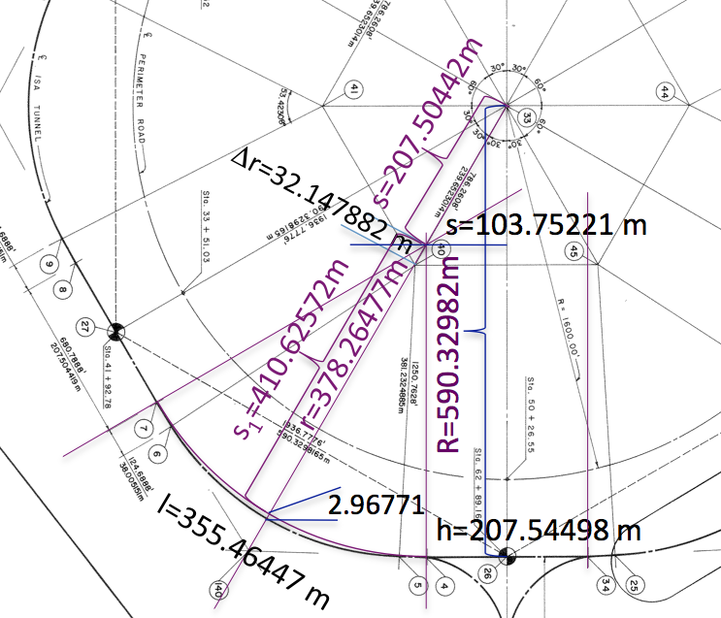

Slide 7
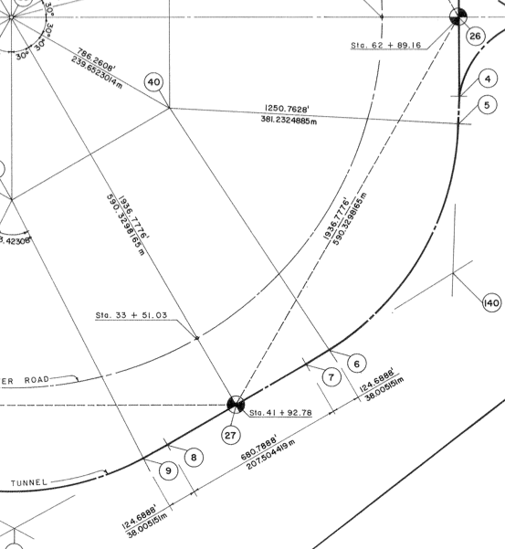
RHIC GEOMETRICAL ARC LAYOUT
r = 381.2324885 m
r = 382.129201572 m
53.42306º
l=355.46433 m
l=356.30043673 m

Slide 8
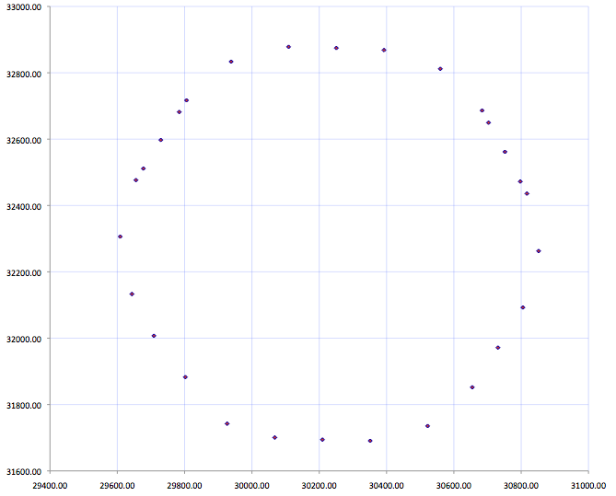
Linac @ 10
Linac @ 4

Slide 9
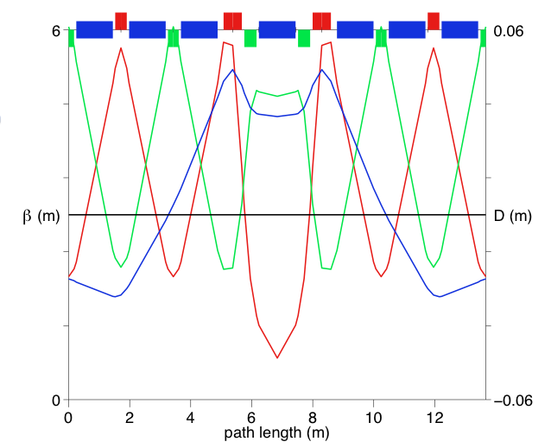
Arc cell with separated function magnets
β_{y}
β_{x}
D_{x}

Slide 10
Arc lattice with separated function magnets
E_{MAX}=30.0 GeV, BRHO = 100.069228545 Tm
Dipoles:
L=1.2 m, θ=0.005123124, B=0.427222589 T,
R=234 m (12 passes 7.5 MW) - 182 dipoles per sextant
Quadrupoles:
L_{fodo}= 0.40 m, G_{f} = 191.3245 T/m, G_{d} = -164.3118 T/m
L_{qf3} = 0.60 m, G_{f} = 212.739 T/m
L_{qd2} = 0.44 m, G_{d} =-202.53 T/m
Length of the arc cell= 13.6717 m
Seven dipoles per cell, 26 cells = 355.46433 m
Total dipole number per sextant 26•7=182.

Slide 11
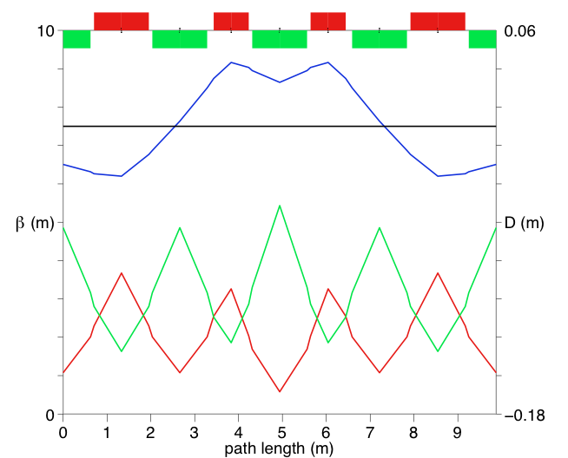
Arc cell with combined function magnets
D_{x}
β_{y}
β_{x}

Slide 12
Arc lattice combined function magnets properties
E_{MAX}=30.0 GeV, BRHO = 100.0692 Tm
Combined Function Magnets:
L=1.2 m, θ=0.00356, B=0.28481 T,
R=351 m (For twelve passes deposited energy is 5.0 MW)
Gradients for focusing in the FODO cells:
G_{f} = 120 T/m and for defocusing G_{d} = -107 T/m.
Combined function magnets in the middle of the cell:
L_{qf3} = 0.80 m, G_{f} = 220 T/m L_{qd2} = 1.2 m, G_{d} =-121 T/m
Length of the arc cell= 9.8740 m
36 cells • 9.8740= 355.46433 m
Total dipole number per sextant 36•(6+2•QLF3/BL)=262.08

